Slide 1


Agenda
Introduction To
Access Specifiers
Strings
Arrays
Enums
Exception Handling

Slide 2
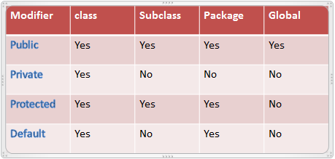
Access Specifiers

Slide 3

string

Slide 4
Strings
Strings represent a sequence of characters placed in a double quotes.
No need to use constructor every time.
Immutable.
Concatenation with +
Equal evaluation: myString.equals(otherString)
StringBuilder and StringBuffer to manipulate String
Important method: Object.toString()

Slide 5
Strings
CREATION
Char data[]= {‘H’,’I’};
String str = new String(data);
String str = "Hi!";
BEWARE OF NULL
MANY USEFUL FEATURES
String nullString = null;
if (nullString != null) { // Check
...
}
nullString.isEmpty(); // NPE!
int length = s.length();
char firstChar = s.charAt(0);
char[] carr = s.toCharArray();
boolean isExecutable = s.endsWith(".exe");
boolean isEmpty = s.isEmpty();
int aidx = s.indexOf('a');
boolean hasEM = s.contains('!');
String upper = s.toUpperCase();
String hai = s.substring(1, 3);
String haiThere = hai + " there".
String[] haiThereArr = haiThere.split(" ");

Slide 6
Strings
Iteration of its chars:
replaceAll(), split(), substring(), equalsIgnoreCase(),
toLowerCase(), toUpperCase()
for (int i=0; i<s.length(); ++i) {
char act = s.charAt(i);
...
}
for (char act : s.toCharArray()) {
...
}
Comparison: equals() and equalsIgnoreCase()
boolean b1 = "a".equalsIgnoreCase(“A") //returns true
boolean b2 = "a".equals("a"); //returns true
Don't forget: immutable structure!
String string = "AAAxAAA";
string.replace('x', 'A');
System.out.println(string); // "AAAxAAA"
string = string.replace('x', 'A');
System.out.println(string); // "AAAAAAA"

Slide 7
String Buffer & String Builder
Use StringBuilder/StringBuffer :
StringBuffer sb = new StringBuffer();
sb.append("Hello ").append("World");
sb.reverse();
System.out.println( sb.toString() ); // "dlroW olleH"
sb.reverse();
sb.setCharAt(5, '-');
System.out.println( sb.toString() ); // "Hello-World"
sb.deleteCharAt(5);
System.out.println( sb.toString() ); // "HelloWorld"
sb.delete(0, sb.length() );
System.out.println( sb.toString() ); // ""
StringBuffer is thread-safe (since 1.0)
StringBuilder is not (since 1.5)
Notes:
Write a code to compare String + operator, StringBuilder.add() and StringBuffer.add() performance

Slide 8

Arrays

Slide 9
Arrays
An array is a container object that holds a fixed number of values of a single type.
Syntax:
int[] scores = new int[2];
scores[0] = 10;
scores[1] = scores[0];
In place initialization of multidimensional array:
String[][] names = {
{"Mr. ", "Mrs. ", "Ms. "},
{"Smith", "Jones"}
};
// Mr. Smith
System.out.println(names[0][0] + names[1][0]);
// Ms. Jones
System.out.println(names[0][2] + names[1][1]);

Slide 10
Arrays
There's a T[] type for every T type
Indexing: from 0
Out of bounds check: ArrayIndexOutOfBoundsException
Default values for the elements (null, 0, false, ...)
Initialization:
Iteration:
int iarr[] = { 1, 2, 3, 4, 5 };
for (int i=0; i<iarr.length; ++i) {
System.out.println(iarr[i]);
}
// barr1, barr2, barr3 are equivalent
boolean[] barr1 = { true, false };
boolean[] barr2 = new boolean[] { true, false }; // as an expression, it's mandatory!
boolean[] barr3 = new boolean[2];
barr3[0] = true; barr3[1] = false;

Slide 11
Arrays
Multi dimension:
public static void enumerate(int[][] arr) {
for (int i=0; i < arr.length; ++i) {
for (int j=0; j < arr[i].length; ++j) {
System.out.print( arr[i][j] + " " );
}
}
}
...
enumerate( new int[][] {
{0, 1},
{2, 3}
});
Initialization: first dimension has to be specified
int[][] arr = new int[2][2];

Slide 12
Array type expressions
New is required:
public static int sum(int[] array) { ... }
public static void main(String[] args) {
int results[] = new int[4];
int result = sum( new int[] {1, 2, 3} );
}
UTILITY CLASS
See java.util.Arrays, many useful features (toString(), fill(), sort(), etc.).
Details: https://docs.oracle.com/javase/8/docs/api/java/util/Arrays.html
Notes:
Check source code of Arrays.java, examine
which ordering algorithm is applied for primitive types/objects
which search algorithm is applied?
http://www.docjar.com/html/api/java/util/Arrays.java.html

Slide 13
Enumerations
public enum FruitsEnum {
Banana(1, “yellow"), Orange(2, “orange);
private int fruitValue;
private String fruitColor;
public String getFruitColor() {
return fruitColor;
}
public int getFruitValue() {
return fruitValue;
}
RequestActionEnum(int fruitValue, String fruitColor) {
this.fruitValue = fruitValue;
this.fruitColor = fruitColor;
}
}
Introduced in Java 5.0
Used for predefined set of constants, like type of fruits:
Could have data fields and constructors.
Could be easily used in switch formula.

Slide 14


Exceptions
What is an Exception
An exception is an unwanted or unexpected event, which occurs during the execution of a program i.e at run time, that disrupts the normal flow of the program’s instructions.
Error
Error is irrecoverable .
e.g. OutOfMemoryError, VirtualMachineError, AssertionError etc.

Slide 15
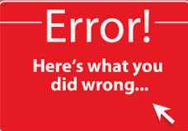
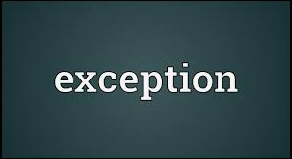
Error vs Exception
Error: An Error indicates serious problem that a reasonable application should not try to catch.
Exception: Exception indicates conditions that a reasonable application might try to catch.

Slide 16
Exception Hierarchy
The following is the class hierarchy for Java exceptions:
Throwable(String message)
getMessage():String
printStackTrace() :void
Throwable
Error
Exception

Slide 17
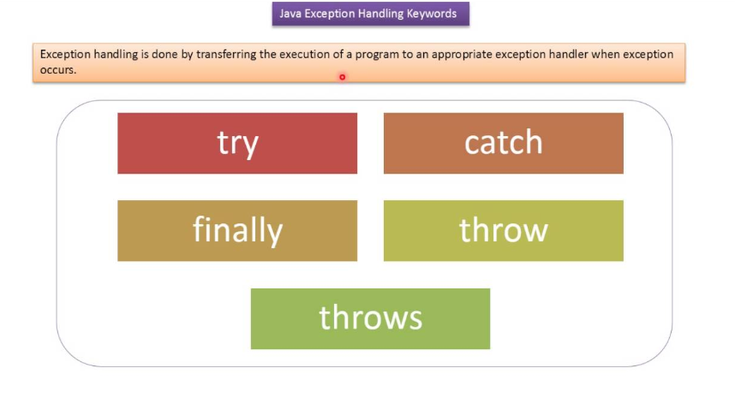
Exception Handling Keywords

Slide 18
Exception Handling Keywords
try :
try is a block. The try block is used to enclose the code that might throw an exception
catch :
Java catch block is used to handle the Exception by declaring the type of exception within the parameter.
The catch block must be used after the try block only. You can use multiple catch block with a single try block.
try{
//critical statements
}catch(Exception e){
//handled the critical statements
}

Slide 19
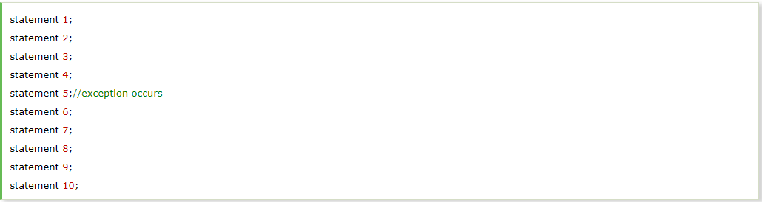
Advantage of Exception Handling
Maintain the normal flow of program.
Meaningful Error Reporting.
Suppose there are 10 statements in your program and there occurs an exception at statement 5, the rest of the code will not be executed i.e. statement 6 to 10 will not be executed. If we perform exception handling, the rest of the statement will be executed. That is why we use exception handling in Java

Slide 20
Advantage of Exception Handling
public class TestException {
public static void main(String[] args) {
String input = null;
int length = 0;
length = input.length();
StringBuilder readInput = new StringBuilder("Java Exceptions");
System.out.println(readInput);
}
}
Output: Exception in thread "main" java.lang.NullPointerException
at TestException.main(TestException.java:5)

Slide 21
Advantage of Exception Handling
public class TestException {
public static void main(String[] args) {
String input = null;
int length = 0;
try {
length = input.length();
} catch (NullPointerException e) {
e.printStackTrace();
}
StringBuilder readInput = new StringBuilder("Java Exceptions");
System.out.println(readInput);
}
}
Output: java.lang.NullPointerException
Java Exceptions
at TestException.main(TestException.java:7)

Slide 22
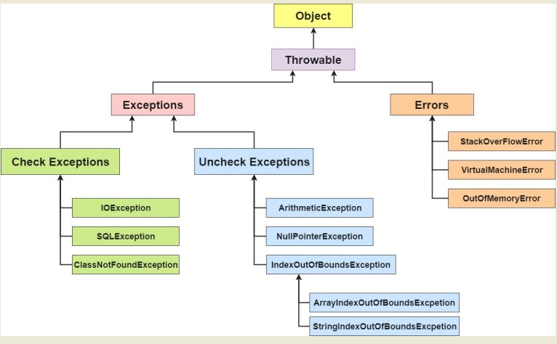
Detailed Exception Hierarchy

Slide 23
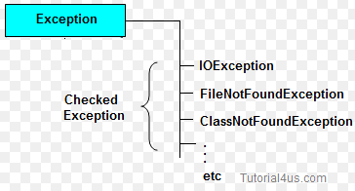
Checked Exception
Checked: are the exceptions that are checked at compile time. If some code within a method throws a checked exception, then the method must either handle the exception or it must specify the exception using throws keyword.

Slide 24
Checked Exception Example
Example:
The following Java program that opens file at location “C:\test\ testData.txt” and prints the first three lines of it.
import java.io.BufferedReader;
import java.io.FileReader;
public class TestReadFile {
public static void main(String[] args) {
FileReader file=new FileReader("C:\\test\\testData.txt");
BufferedReader fileReader=new BufferedReader(file);
for(int counter=0;counter<3;counter++){
System.out.println(fileReader.readLine());
}
fileReader.close();
}
}

Slide 25
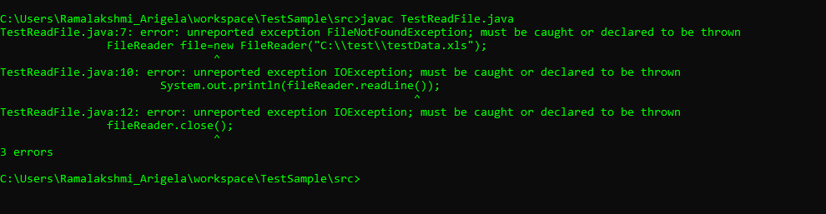
Checked Exception

Slide 26
Checked Exception
public class TestReadFile {
public static void main(String[] args) {
try{
FileReader file=new FileReader("C:\\test\\testData.txt");
BufferedReader fileReader=new BufferedReader(file);
String st;
while ((st = fileReader.readLine()) != null) {
System.out.println(st);
}
fileReader.close();
}catch(FileNotFoundException e){
e.printStackTrace();
}catch(IOException e){
e.printStackTrace();
}
}
}

Slide 27
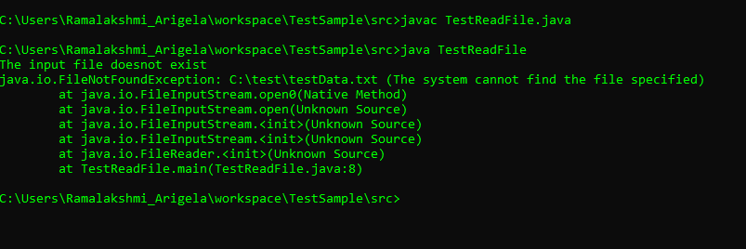
Checked Exception
Scenario : Input file doesn’t exist:

Slide 28
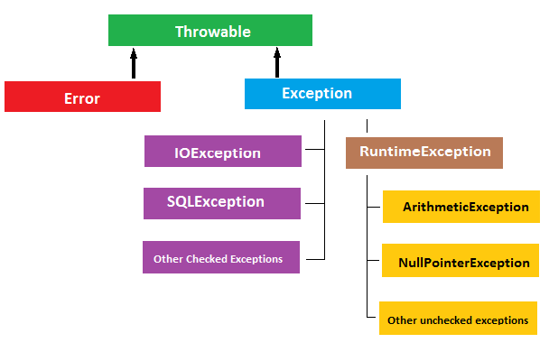
Unchecked Exception
Unchecked are the exceptions that are not checked at compiled time.
The classes which inherit RuntimeException are known as unchecked exceptions

Slide 29
UnChecked Exception
public class TestUnChecked {
public static void main(String[] args) {
try {
int result=10/0;
} catch (ArithmeticException e) {
System.out.println(e.getMessage());
e.printStackTrace();
}
System.out.println("Rest of the code");
}
}
Output: / by zero
Rest of the code
java.lang.ArithmeticException: / by zero
at TestUnChecked.main(TestUnChecked.java:6)

Slide 30
Best practices
public class TestUnchecked {
public static void main(String[] args) {
int i=10;
int j=0;
int result;
if(j!=0){
result=i/j;
}
System.out.println("Rest of the code");
}
}
Output:
Rest of the code

Slide 31
Java finally block
Java finally block is a block that is used to execute important code such as closing connection, stream etc.
Java finally block is always executed whether exception is handled or not.
Java finally block follows try or catch block.
Syntax:
finally{
}

Slide 32
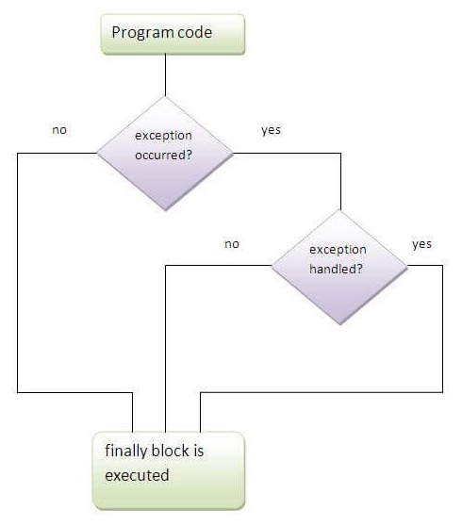
Java finally block

Slide 33
finally block Example
class TestFinallyBlock{
public static void main(String args[]){
try{
int data=25/5;
System.out.println(data);
} catch(NullPointerException e){
System.out.println(e);
} finally{
System.out.println("finally block is always executed");
}
System.out.println("rest of the code...");
}
}

Slide 34
Java throws block
The Java throws keyword is used to declare the exception information that may occur during the program execution.
Example: public class TestThrows1{
static void validate(int age) throws ArithmeticException{
if(age<18)
throw new ArithmeticException("not valid");
else
System.out.println("welcome to vote");
}
public static void main(String args[]){
validate(13);
System.out.println("rest of the code...");
}
}

Slide 35
Java throw block
Java throw keyword is used to explicitly throw an exception. We can throw either checked or uncheked exception in java by throw keyword. The throw keyword is mainly used to throw custom exception.
Example: public class TestThrow1{
static void validate(int age){
if(age<18)
throw new ArithmeticException("not valid");
else
System.out.println("welcome to vote");
}
public static void main(String args[]){
validate(13);
System.out.println("rest of the code...");
}
}

Slide 36
Practice Task
Please complete the below Practice task
Input a string of alphabets. Find out the number of occurrence of all alphabets in that string. Find out the alphabet with maximum occurrence.
Write a program that takes your full name as input and displays the abbreviations of the first and middle names except the last name which is displayed as it is. For example, if your name is Robert Brett Roser, then the output should be R.B.Roser.
Write a program to find the sum and product of all elements of an array.

Slide 37
Q & A

Slide 38
THANK YOU!
Notes:
Thanks for your attention

